Slide 1
HOUSING: PRICE PREDICTION MODEL
-Presented By-
Himanshu Sharma

Slide 2
INTRODUCTION
A US-based housing company named Surprise Housing has decided to enter the Australian market. The company uses data analytics to purchase houses at a price below their actual values and flip them at a higher price. For the same purpose, the company has collected a data set from the sale of houses in Australia.
The data is provided in the CSV file below. The company is looking at prospective properties to buy houses to enter the market. You are required to build a model using Machine Learning in order to predict the actual value of the prospective properties and decide whether to invest in them or not. For this company wants to know:
Which variables are important to predict the price of variable?
How do these variables describe the price of the house?

Slide 3
Business Problem
Business problem in this project,we are required to model the price of houses with the available independent variables. This model will then be used by the management to understand how exactly the prices vary with the variables. They can accordingly manipulate the strategy of the firm and concentrate on areas that will yield high returns. Further, the model will be a good way for the management to understand the pricing dynamics of a new market.

Slide 4
Motivation
Motivation for the problem undertaken because project scenario basically model will then be used by the management to understand how exactly the prices vary with the variables. They can accordingly manipulate the strategy of the firm and concentrate on areas that will yield high returns. Further, the model will be a good way for the management to understand the pricing dynamics of a new market.

Slide 5
Review of Dataset
Review of Dataset is basically related to comprehensive summary of dataset as well as descriptions of input variables and output variable.

Slide 7
Statistical Descriptions
The statistical descriptions of dataset using Dataframe.describe() command in python, which tells the following statistical descriptions:

Slide 8
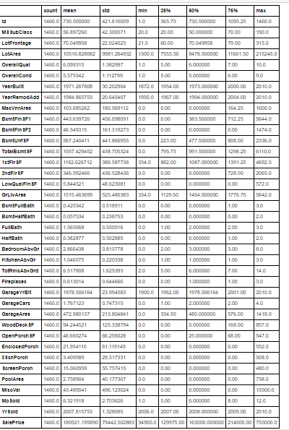

Slide 9
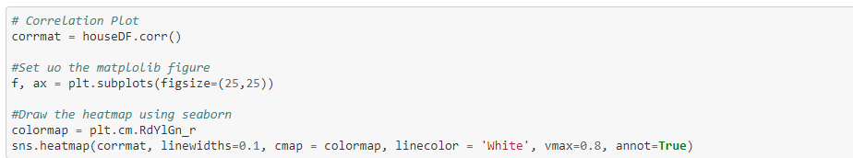
Data Inputs-Output Relationships
Python is a great language for doing data analysis, primarily because of the fantastic ecosystem of data-centric python packages. Pandas is one of those packages and makes importing and analyzing data much easier.
Pandas dataframe.corr() is used to find the pairwise correlation of all columns in the dataframe.

Slide 10
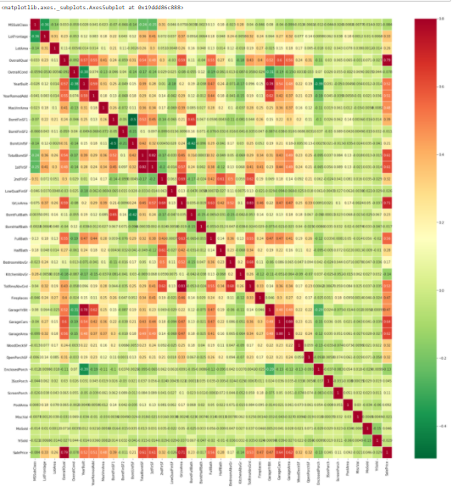

Slide 11
Data Preprocessing
Data pre-processing in Machine Learning is a crucial step that helps enhance the quality of data to promote the extraction of meaningful insights from the data. In simple words, data pre-processing in Machine Learning is a data mining technique that transforms raw data into an understandable and readable format.

Slide 12
Data Preprocessing Conti..
Steps in Data Pre-processing in Machine Learning:
Acquire the dataset
Import all the crucial libraries
Import the dataset
Identifying and handling the missing values
Encoding the categorical data
Splitting the dataset
Feature scaling

Slide 13
CONCLUSION
After analysing data, visualization and modelling, we come to the conclusion that using the ada boost regression is the best random state corresponding to highest r2_score is 85.

Slide 14
Thank You..

